Slide 1

INTRODUCTION
TO GIT & GITHUB

Slide 2
Git != Github

Slide 3

What is Git?
Git is a method of version control
Version control is a snapshot of your folder at the stage you’ve “saved” it
These ”snapshots” are saved in case you need to revert back to an older version

Slide 4

What is Github?
Github is a website where you can store and share your Github repository (or repo)
Github has an easy to use interface
It offers collaboration tools like “forks” and “pull requests”

Slide 5
Git Workflow

Slide 6
Working Directory
Staging Area
Repository
Git is made up of three independent “phases” of code tracking.
Let’s investigate each section.

Slide 7
The working directory area is our “normal” file system. This tracks the code as it exists on our computer right now.
If we’ve made changes, then the working directory sees all of those changes.
It doesn’t track any history. It just says, “this is how my code looks right now.”
Working Directory
Staging Area
Repository

Slide 8
The staging area is how we prepare for a commit.
Before making a commit, we’ll tell git that we want certain files to be “staged” for the commit.
In non-git terms, we’re telling git that we want it to check this file to see if it’s changed since the last checkpoint.
Working Directory
Staging Area
Repository

Slide 9
The repository is where all of our checkpoints live.
Every time we make a commit, all of those changes are pushed into the repository.
The repository is the holder of all knowledge about each version of a project.
Until the code is committed to the repository, no checkpoints have been made.
Working Directory
Staging Area
Repository

Slide 10
Working Directory
Staging Area
Repository
The flow of using Git

Slide 11
Working Directory
Staging Area
Repository
Code. Code. Code.
I work on my code in the working directory.

Slide 12
Working Directory
Staging Area
Repository
Code. Code. Code.
Code. Code. Code.
Now let’s get it ready for a checkpoint.
I need to tell git to ‘add’ it to the staging area.
git add my_code_file.py

Slide 13
Working Directory
Staging Area
Repository
Code. Code. Code.
Code. Code. Code.
At this point, I haven’t made the checkpoint, I’ve just prepared for it.
Now let’s actually make the commit.

Slide 14
Working Directory
Staging Area
Repository
Now we’ve actually made a commit.
All the things in the staging area are added to the repository and a special name is given to this version of the code.
Code. Code. Code.
Code. Code. Code.
Code. Code. Code.
git commit –m “making my first checkpoint”

Slide 15
Working Directory
Staging Area
Repository
This is called a “commit message” and it’s vitally important that you take it seriously.
The special name that git gives to each checkpoint is just a series of characters like “d9rgy6431abql”.
If you ever need to go back in time to a certain bit of code, you need to have a message that clearly identifies the commit’s purpose.
Code. Code. Code.
Code. Code. Code.
Code. Code. Code.
git commit –m “making my first checkpoint”

Slide 16
Commit Message Guide
Commit messages should:
Clearly state what’s changed since the last commit
Tell us what bugs were fixed, and what new code was added
If we remove the -m “message here” part from the previous example, we will be taken to a text editor to make our commit messages instead and can make it more specific.

Slide 17
Working Directory
Staging Area
Repository
Code. Code. Code.
Code. Code. Code.
Code. Code. Code.
At this point our repository and our working directory match.
Code. Code. Code.

Slide 18
Working Directory
Staging Area
Repository
Code. Code. Code.
Code. Code. Code.
Code. Code. Code.
If we go through the process again, we can see that we’ll add a new commit that also lives in the repository.
Code. Code. YEAH.

Slide 19
Working Directory
Staging Area
Repository
Code. Code. Code.
Code. Code. Code.
Code. Code. Code.
If we go through the process again, we can see that we’ll add a new commit that also lives in the repository.
Code. Code. YEAH.
Code. Code. YEAH.
Code. Code. YEAH.

Slide 20
Git: A quick review
Git gives us the ability to track our code over time
It provides a flexible interface for making checkpoints (called commits)
It gives us the history of our code, and the ability to reset to a previous status

Slide 21
GitHub Workflow

Slide 22
GitHub
GitHub looks at what git does and asks the question, “what if I want lots of people to be sharing code?”
It adds an online component of code sharing
It adds a new phase to our “3 phases of Git”
It allows the repo to live somewhere other than your computer, so your backups are backed up

Slide 23
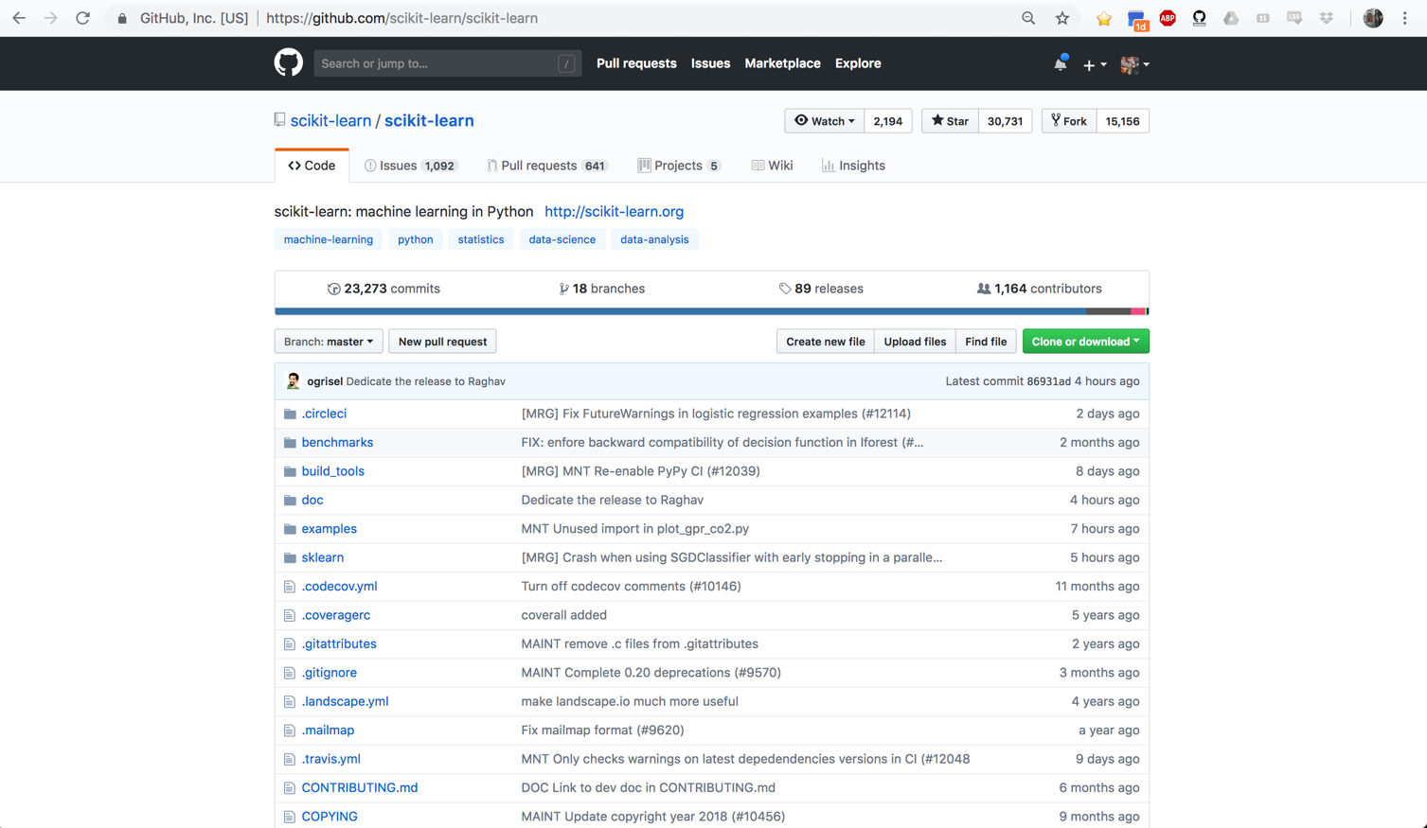

Slide 24
1000+ Coders

Slide 25
23,000+ Commits

Slide 26
All of Scikit Learn

Slide 27
Working Directory
Staging Area
Repository
Remote Repo on GitHub
Code. Code. Code.
Code. Code. Code.
Code. Code. Code.
My Computer
GitHub’s Servers

Slide 28
GitHub: Remote vs Local
We use pushes and pulls to move the current version of our repo between our computer and a “remote” version of the repo
A push says, “make the remote version look like my code” and in particular it updates any files that changed in the last commits
A pull says, “bring in any changes that have occurred on the remote version of the repo and make my code match those”

Slide 29
Working Directory
Staging Area
Repository
Remote Repo on GitHub
Code. Code. Code.
Code. Code. Code.
Code. Code. Code.
Push
Code. Code. Code.

Slide 30
Working Directory
Staging Area
Repository
Remote Repo on GitHub
Code. Code. Code.
Code. Code. Code.
Code. Code. Code.
Push
Code. Code. Code.
Teammate makes an edit and push

Slide 31
Working Directory
Staging Area
Repository
Remote Repo on GitHub
Code. Code. Code.
Code. Code. Code.
Code. Code. Code.
Push
Code. Code. Code.
Updated code
Code. Code. Whoo!

Slide 32
Working Directory
Staging Area
Repository
Remote Repo on GitHub
Code. Code. Code.
Code. Code. Code.
Code. Code. Code.
Push
Code. Code. Code.
Updated code
These don’t match now.
Code. Code. Code.
Code. Code. Whoo!

Slide 33
Working Directory
Staging Area
Repository
Remote Repo on GitHub
Code. Code. Code.
Code. Code. Code.
Code. Code. Code.
Push
Code. Code. Code.
Updated code
Code. Code. Whoo!
Pull
Code. Code. Whoo!

Slide 34
Summary
Git and GitHub are powerful tools for maintaining code
Git allows us to create checkpoint via commits, and give us the power to move back in time if we break our code
GitHub allows us to share our code with others and allows multiple people to make changes to the code.

Slide 35
Best Practice
A smart person would keep a GitHub repo for all of their projects. They would create one right after this lecture for project 1. That way, if they happen to spill coffee on their laptop, their code is backed up.
It’s a good idea to commit/push often. I usually do so after every completed “point” in my code. Finished a few functions that now work together? Commit. Updated comments in the code? Commit.

Slide 36
The Metis Workflow
Setting up your forked repo

Slide 37
github.com/
thisismetis/
onl20_ds4

Slide 38
github.com/
thisismetis/
onl20_ds4

Slide 39
github.com/
thisismetis/
onl20_ds4
1. fork
github.com/
adashofdata/
onl20_ds4

Slide 40
github.com/
thisismetis/
onl20_ds4
1. fork
github.com/
adashofdata/
onl20_ds4
2. `git clone`
onl20_ds4

Slide 41
“upstream”
“origin”
github.com/
thisismetis/
onl20_ds4
1. fork
github.com/
adashofdata/
onl20_ds4
2. `git clone`
onl20_ds4

Slide 42
“upstream”
“origin”
github.com/
thisismetis/
onl20_ds4
1. fork
github.com/
adashofdata/
onl20_ds4
2. `git clone`
onl20_ds4
This is a one time thing.

Slide 43
“upstream”
“origin”
curriculum is added
github.com/
thisismetis/
onl20_ds4
github.com/
adashofdata/
onl20_ds4
onl20_ds4

Slide 44
“upstream”
“origin”
curriculum is added
github.com/
thisismetis/
onl20_ds4
github.com/
adashofdata/
onl20_ds4
3. `git pull upstream master`
onl20_ds4

Slide 45
“upstream”
“origin”
curriculum is added
github.com/
thisismetis/
onl20_ds4
github.com/
adashofdata/
onl20_ds4
3. `git pull upstream master`
onl20_ds4
curriculum is added

Slide 46
“upstream”
“origin”
curriculum is added
github.com/
thisismetis/
onl20_ds4
github.com/
adashofdata/
onl20_ds4
3. `git pull upstream master`
onl20_ds4
curriculum is added
You do this every day.

Slide 47
The Metis Workflow
Submitting Challenges and Investigation Slides

Slide 48
“upstream”
“origin”
github.com/
thisismetis/
onl20_ds4
github.com/
adashofdata/
onl20_ds4
onl20_ds4
homework submission

Slide 49
“upstream”
“origin”
github.com/
thisismetis/
onl20_ds4
github.com/
adashofdata/
onl20_ds4
onl20_ds4
Repository
onl20_ds4
Staging
Working Directory
homework submission

Slide 50
“upstream”
“origin”
github.com/
thisismetis/
onl20_ds4
github.com/
adashofdata/
onl20_ds4
onl20_ds4
1. `git add my_homework`
Repository
onl20_ds4
Staging
Working Directory
homework submission

Slide 51
“upstream”
“origin”
github.com/
thisismetis/
onl20_ds4
github.com/
adashofdata/
onl20_ds4
onl20_ds4
1. `git add my_homework`
Repository
onl20_ds4
Staging
homework submission
Working Directory

Slide 52
“upstream”
“origin”
github.com/
thisismetis/
onl20_ds4
github.com/
adashofdata/
onl20_ds4
onl20_ds4
2. `git commit -m “submitted homework”`
Repository
onl20_ds4
Staging
homework submission
Working Directory

Slide 53
“upstream”
“origin”
github.com/
thisismetis/
onl20_ds4
github.com/
adashofdata/
onl20_ds4
onl20_ds4
2. `git commit -m “submitted homework”`
Repository
homework submission
onl20_ds4
Staging
Working Directory

Slide 54
“upstream”
“origin”
github.com/
thisismetis/
onl20_ds4
github.com/
adashofdata/
onl20_ds4
onl20_ds4
3. `git push origin master`
Repository
homework submission
onl20_ds4
Staging
Working Directory

Slide 55
“upstream”
“origin”
homework submission
github.com/
thisismetis/
onl20_ds4
github.com/
adashofdata/
onl20_ds4
onl20_ds4
3. `git push origin master`
Repository
onl20_ds4
Staging
Working Directory

Slide 56
“upstream”
“origin”
homework submission
github.com/
thisismetis/
onl20_ds4
github.com/
adashofdata/
onl20_ds4
4. Submit URL through
Google Form
onl20_ds4
3. `git push origin master`
Repository
onl20_ds4
Staging
Working Directory

Slide 57
The Metis Workflow
Submitting Project code

Slide 58
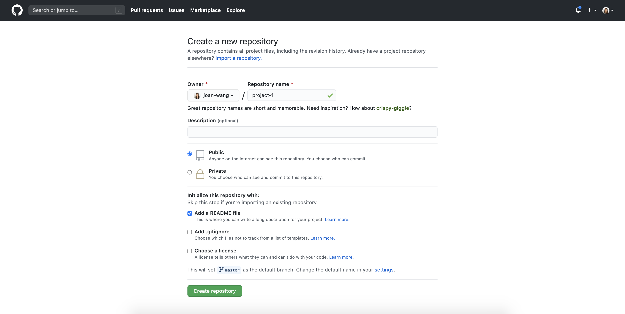
1. Create a new repo

Slide 59
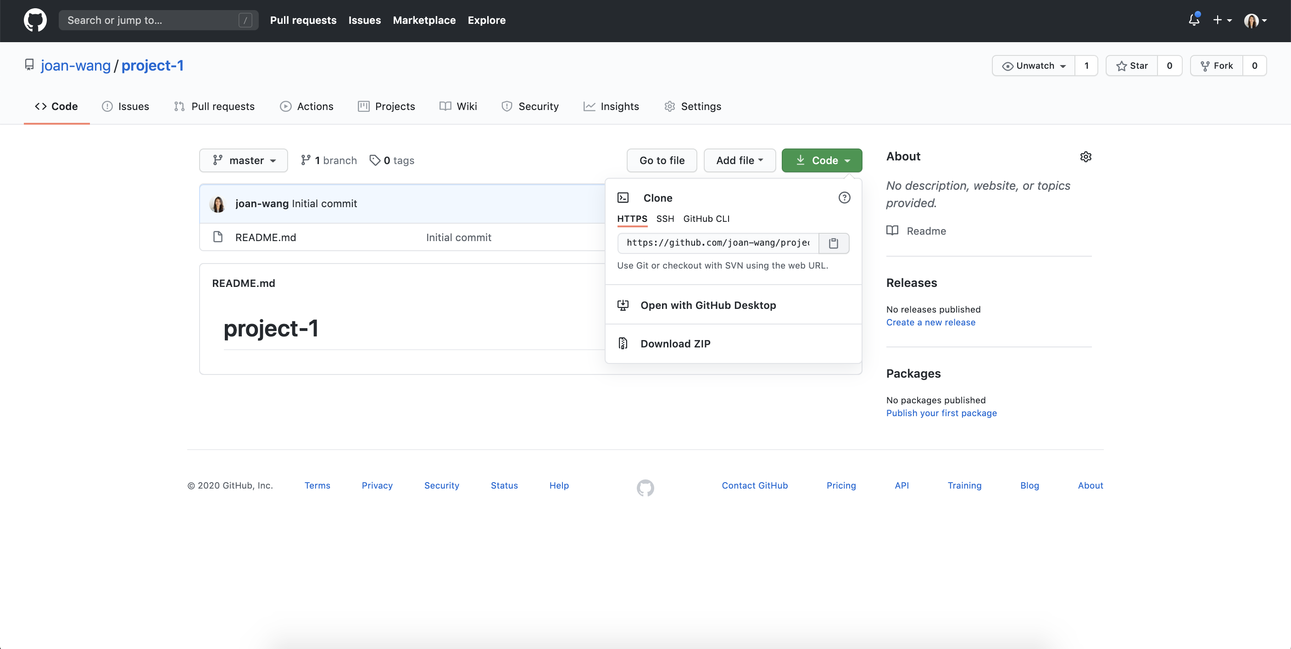

2. Clone the repo onto your local computer
1. Create a new repo

Slide 60
3. Code up your project, going through the add --> commit --> push process as needed
4. Submit URL through Google Form

Slide 61
Let’s Try It Out!

Slide 62

QUESTIONS?

Slide 63
How to Undo Something

Slide 64
Working Directory
Staging Area
Repository
Code. Code. Code.
Code. Code. Code.
Code. Code. Code.
What if I want to revert to the original commit?
Code. Code. YEAH.
Code. Code. YEAH.
Code. Code. YEAH.

Slide 65
Git Log
There’s a command underneath git called git log. It displays a list of all the previous commits and information about them.

Slide 66
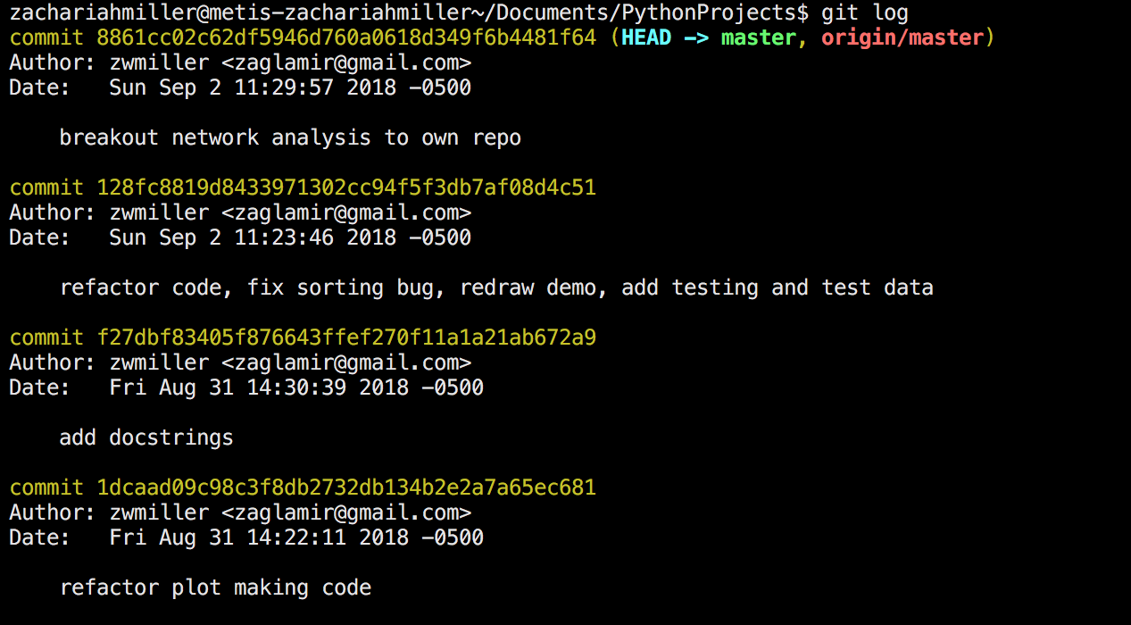

Slide 67
Commit IDs

Slide 68
Commit Messages

Slide 69
Git Reset
So if I want to return to a previous state of code, I can just find the correct commit id then tell git to reset to that state.
git reset 128fc8819d8433971302cc94f5f3db7af08d4c51

Slide 70
Working Directory
Staging Area
Repository
Code. Code. Code.
Code. Code. Code.
Code. Code. Code.
Before reset.
Code. Code. YEAH.
Code. Code. YEAH.
Code. Code. YEAH.

Slide 71
Working Directory
Staging Area
Repository
Code. Code. Code.
Code. Code. Code.
Code. Code. Code.
After reset.
Code. Code. Code.

